Slide 1



Power BI Desktop
Mentorness Internship Project By Neha Goyal

Slide 2
Contents
Power BI Desktop
Problem Statement
Objective
Data Cleaning
Analysis
Fatality Analysis Temporal Analysis Geospatial Analysis
Analysis Conclusions

Slide 3
Power BI Desktop
Problem Statement
This internship project aims to analyze airplane crashes and fatalities spanning from 1980 to 2023, using Power BI for interactive visualizations and insights. By examining crucial data such as crash dates, locations, operators, flight details, aircraft types, and fatality statistics, the goal is to uncover patterns, contributing factors, and trends in aviation incidents. Ultimately, this analysis seeks to provide stakeholders with actionable insights to enhance aviation safety and mitigate risks.

Slide 4
OBJECTIVE
.Temporal Analysis:
-Explore temporal trends in airplane crashes over the years.
-Identify patterns in the frequency and severity of
incidents.
Power BI Desktop
Aircraft Analysis:
-Analyze the involvement of specific aircraft types in incidents.
-Examine the relationship between aircraft
registration and crash occurrences..
Geospatial Analysis:
-Visualize crash locations on a map to identify hotspots.
-Analyze the distribution of incidents across
different regions.
Fatality Trends:
-Explore trends in passenger and crew fatalities.
-Investigate factors contributing to fatalities. Route Analysis:
Route Analysis:
-Analyze incident patterns on specific flight routes.
-Identify routes with a higher likelihood of incidents.
Operator Performance:
-Evaluate the safety records of different operators and airlines.
-Identify operators with higher incident rates.

Slide 5
Power BI Desktop
Data Cleaning Process
The data cleaning process entails several steps to ensure the dataset's quality and reliability. These steps involve handling missing values, standardizing formats, and verifying data accuracy and consistency.
Furthermore, to enhance the dataset's analytical depth, new columns have been added. The
"Country" column provides contextual information by specifying the country where each incident occurred.
In summary, the meticulous data cleaning and enrichment procedures contribute to a well-
prepared dataset, facilitating accurate analysis and informed decision-making in aviation safety.
.

Slide 6


Power BI Desktop
V
☐
: Comox-Port Hardy
14099
Douglas DC-3 4.7K Antonov An-26 1.2K Douglas C-47 1.1K Douglas DC-6B 1.1K Ilyushin IL-18B 1.0K
McDonnell Dougl… 1.0K Tupolev TU-154M 0.9K Douglas DC-4 0.9K
de Havilland Cana… 0.8K Tupolev TU-134A 0.8K
0K
129K
Sum of Aboard Passangers
5193
N736PA/PH-BUF
583
JA8119
520
HZ-AIH/UN-76435
349
21K
Sum of Aboard Crew
TC-JAV
346
2K
4K
0K
5K
20K
Sum of Fatalities Passangers
1,500
1367
1170
Sum of Fatalities
15K
14.6K
1,000
942
10K
6.5K
4.4K
560
500
477
5K
1.3K
0.2K 0.1K
20
1.3K
0.0K
0.0K
1
0
0
125
95110
100
0K
0
10
30
40
50
200
300
400
500
600

Slide 7



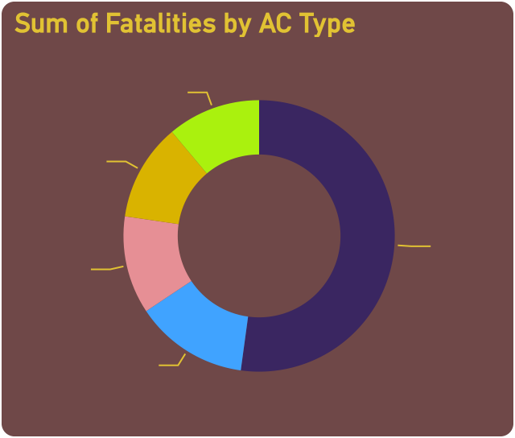
112K
Sum of Fatalities
Power BI Desktop
46%
54%
17K
Sum of Fatalities Crew
155K
Sum of Aboard
91K
Sum of Fatalities Passa…
V
V
V
All V
All V
All V
8%
9%
11%
53%
20%
100
88
83
11%
56
53
50
45
50
12%
52%
25
12%
1
4
13%
0
1900
1920
1940
1960
1980
2000
2020
2040
Year

Slide 8

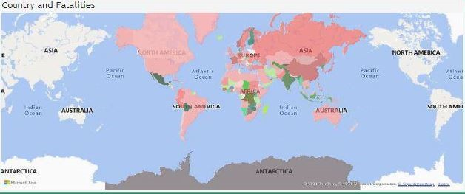

2254
Count of Operator
Power BI Desktop
V
2404
Count of AC Type
445
Count of Location
 Atlantic Ocean
 Australia
Bolivia
Brazil
V
☐
46826/109
 A B Aerotransport
Ã¨koda (India) Ltd

Slide 9
Analysis Conclusions
The analysis included the percentage of crew (16%) and passenger (84%) fatalities, providing a deeper understanding of the distribution of fatalities within the aircraft.
Chicago O'Hare, Illinois was the highest airplane fatalities rate in the world with 271 individuals
The year 2001 was the highest airplane fatalities rate in the world.
AC Type: McDonnell Douglas DC-10-10 and the number of fatalities, as it represents the cause of7% of fatalities.
Power BI Desktop

Slide 10
ThankYou
Power BI Desktop

